Slide 1

Software Foundations in JAVA (JSF)
Lesson 1 Introduction
Peter Boots
p.boots@fontys.nl
Erik van der Schriek
e.vanderschriek@fontys.nl

Slide 2
Organization and assessment
See Canvas for details
Written exam at the end
Practical assignments
  Each assignment describes what must be done and what must be shown and/or handed in
  Must be made in a week and shown/handed in using Canvas
    This is a strict deadline → too late == too late
  Must be made in groups of 2 students
  All assignments must be made Satisfactory, then the whole practical is “Satisfactory”.
  All assignments satisfactory? → bonus!

Slide 3
Overview
Introduction JSF
OS’s
Linux
Assignment week 1
Notes:
Next: what is an OS

Slide 4
Introduction
Java
Used during SE education
Software
Best practices, performance, interoperability
Foundations
Operating System, concurrency , API
Notes:
JAVA: multiplatform, netbeans.
Software: best practices during design, solutions for problems, making choices
Foundations: use of Linux and Windows, use of API’s, especially concurrency

Slide 5
What is an Operating System?
A program that acts as an intermediary between a user of a computer and the computer hardware
Operating system goals:
  Execute user programs and make solving user problems easier
  Make the computer system convenient to use
  Use the computer hardware in an efficient manner
  Manage resources
  Controls execution
Notes:
Next: tasks done by OS to achieve goals

Slide 6
Operating-System Operations
Interrupt driven by hardware
Software error or request creates exception or trap
  Division by zero, request for operating system service
Dual-mode operation allows OS to protect itself and other system components
  Protected (user) mode / Supervisor (kernel) mode
    In kernel mode all instructions are allowed and all memory and devices are accessible
    In user mode, some instructions are prohibited and only memory of the process is accessible
  System call changes mode to kernel, return from call resets it to user
Q: will an interrupt be executed in user or kernel mode?

Slide 7
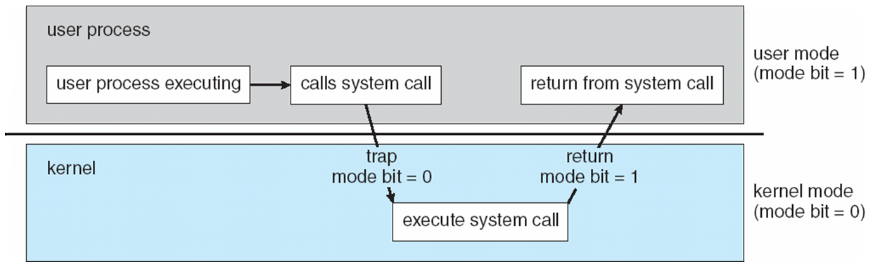
Transition from User to Kernel Mode
Source: Operating System Concepts – 8th Edition, Silberschatz, Galvin and Gagne ©2009

Slide 8
Example system call (C)

Slide 9
OS Management
Program execution (process)
Memory (virtual memory)
Storage (file systems and discs)
I/O

Slide 10
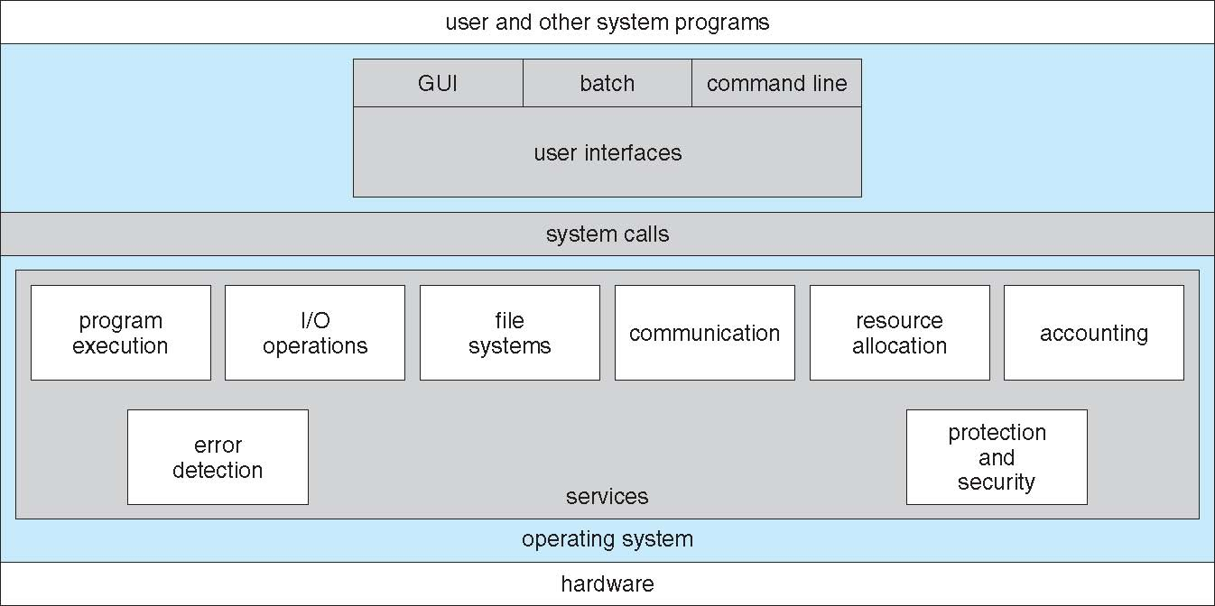
A View of Operating System Services
Source: Operating System Concepts – 8th Edition, Silberschatz, Galvin and Gagne ©2009

Slide 11
System Calls
Programming interface to the services provided by the OS
Mostly accessed by programs via a high-level Application Program Interface (API) rather than direct system call use
Three most common APIs are Win32 API for Windows, POSIX API for POSIX-based systems (including virtually all versions of UNIX, Linux, and Mac OS X), and Java API for the Java virtual machine (JVM)
Q: Why use APIs rather than system calls?

Slide 12
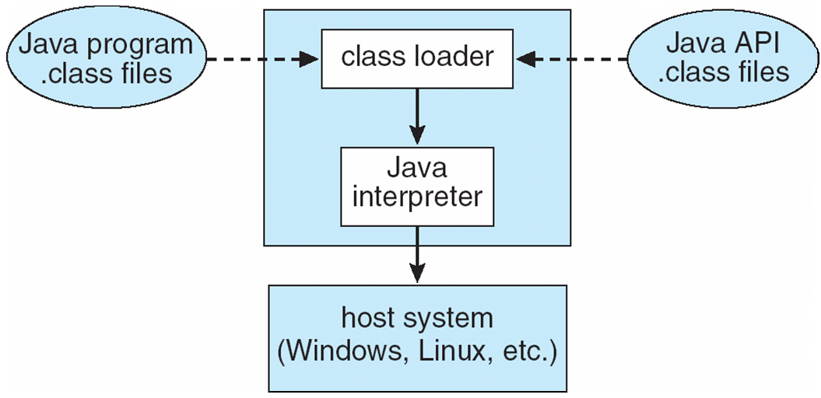
The Java Virtual Machine
Source: Operating System Concepts – 8th Edition, Silberschatz, Galvin and Gagne ©2009
Notes:
JVM is process VM!
Stack: app – jvm – os – virtual hw – hypervisor – HW
JrocketVE: stack: app – jrocket vm – hypervisor – hw
Jrocket: Hypervisor optimized java
Next: Linux

Slide 13
OS Concepts
Layers
API
Kernel & user mode
JVM

Slide 14
Linux
UNICS: 1969 Thompson & Ritchie († oct 2011)
Diverse Unix varianten (closed source)
Richard Stallman: GNU project (1983): tools, compilers
Linus Torvalds: Linux Kernel (1992)
GNU/Linux (free as in speech)
Ubuntu (less free)
Mint

Slide 15
Free (as in speech)
The freedom to use the software for any purpose.
The freedom to study how the program works, and the freedom to make changes to it. (This requires access to the source code).
The freedom to distribute copies of the software to anyone else.
The freedom to distribute your modified copy (see 1).
Note: free (as in beer) means something else (-->you get something, which you don't have to pay for)!
New name: open source (also misused)
License: GNU GPL

Slide 16
Linux
Kernel: monolithic
Server & desktop
Shell on top of kernel: commandline
Window manager (X)
Desktop manager (gnome, Maté, kde)
Software packages (source tree(s))
Separation of administration & preferences
Very nice: fine grained control
Less nice: fine grained settings and configuration.
Notes:
Packages: compare Android/Apple market, only containing sources. Dependancies are known within a tree.
Administration: what SW is present, what does it do on system.
Preference: How does it look & feel for individual user

Slide 17
Command-prompt
login as: student
student@192.168.109.128's password:
Linux debian4cursus 2.6.18-4-686 #1 SMP Wed May 9 23:03:12 UTC 2007 i686
The programs included with the Debian GNU/Linux system are free software;
the exact distribution terms for each program are described in the individual files in /usr/share/doc/*/copyright.
Debian GNU/Linux comes with ABSOLUTELY NO WARRANTY, to the extent
permitted by applicable law.
Last login: Wed Jul 11 16:28:52 2007
student@debian4cursus:~$ date
Wed Jul 11 16:53:57 CEST 2007
student@debian4cursus:~$
General: commandname –flag argument1 argument2 argumentn
Note: the examples are taken from a Debian system, in the practical we will use Mint; both are very similar

Slide 18
UNIX-trivia
^C (control-C) = Abort a command as long as it is being executed (after you started it from the command-line)
exit or sometimes ^D = log off
Tab key for command/filename completion
Case sensitive (HOME != home)
Command history (arrow up, ‘history’, !#)

Slide 19
File management 1
Create or edit a text-file with a text-editor, e.g. nano, vi or gedit
Go to another directory with cd
  cd /example
    go to example, which must be a subdirectory of the root directory (absolute path)
  cd example
    go to example, which must be a subdirectory of the current directory (relative path)
Show properties of files with ls (there are a lot of options, see ls -? )
View the content of files with cat
Change permissions with chmod (details will be explained later)
student@debian4cursus:~$ ls -l
total 8
-rw-r--r-- 1 student student 28 2007-07-11 17:44 readme.txt
-rw-r--r-- 1 student student 64 2007-07-11 17:44 exampletext
student@debian4cursus:~$ cat readme.txt
This is a text in a file
student@debian4cursus:~$ cat exampletext
This is a text-file also, extensions are not necessary in Linux
student@debian4cursus:~$chmod +w file1

Slide 20
Help-function
Use man <command> for options and help, like
man ls
In Linux, most commands have a commandline helpfunction (short) via a flag: <commandname> --help, like
ls --help
student@debian4cursus:~$ cat --help
Usage: cat [OPTION] [FILE]...
Concatenate FILE(s), or standard input, to standard output.
-A, --show-all equivalent to -vET
-b, --number-nonblank number nonblank output lines
-e equivalent to -vE
-E, --show-ends display $ at end of each line
-n, --number number all output lines
-s, --squeeze-blank never more than one single blank line
-t equivalent to -vT
-T, --show-tabs display TAB characters as ^I
-u (ignored)
-v, --show-nonprinting use ^ and M- notation, except for LFD and TAB
--help display this help and exit
--version output version information and exit
With no FILE, or when FILE is -, read standard input.
Examples:
cat f - g Output f's contents, then standard input, then g's contents.
cat Copy standard input to standard output.
Report bugs to <bug-coreutils@gnu.org>.
student@debian4cursus:~$

Slide 21
File management 2
print working directory = pwd
student@debian4cursus:~$ pwd
/home/student
student@debian4cursus:~$ ls -l /home/student
total 8
-rw-r--r-- 1 student student 28 2007-07-11 17:44 readme.txt
-rw-r--r-- 1 student student 64 2007-07-11 17:44 exampletext
student@debian4cursus:~$ ls -l /home/
total 20
drwx------ 2 root root 16384 2007-07-09 21:49 lost+found
drwxr-xr-x 2 student student 4096 2007-07-11 17:44 student
student@debian4cursus:~$ ls -l /
total 51
drwxr-xr-x 2 root root 3072 2007-07-09 22:02 bin
drwxr-xr-x 3 root root 1024 2007-07-09 22:13 boot
lrwxrwxrwx 1 root root 11 2007-07-09 21:49 cdrom -> media/cdrom
drwxr-xr-x 14 root root 4000 2007-07-11 16:28 dev
drwxr-xr-x 54 root root 5120 2007-07-11 18:12 etc
drwxr-xr-x 4 root root 4096 2007-07-09 22:03 home

Slide 22
Security: superuser
The superuser, also called user ‘root’, has userid 0 and is allowed to do more than other users:
  The kernel does not check file permissions for a process running with userid 0
  Root (also) owns all resources of all other users
  Programs that normally need a password, do not need that when they are running with userid 0

Slide 23
superuser
root can do virtually anything, and therefore can cause a lot of damage ☺
Use root only when strictly necessary
For safety, never log in as root, but log in as an ordinary user; use sudo (SuperUser DO) when you need superuser abilities to perform a single command
  sudo only works if your account is in the sudoers list (a list of users that are allowed to use sudo)
  only root can add a name to that list
To switch to SuperUser permanently, use su
student@debian4cursus:~$ sudo chmod +w file1
password for student:
student@debian4cursus:~$

Slide 24
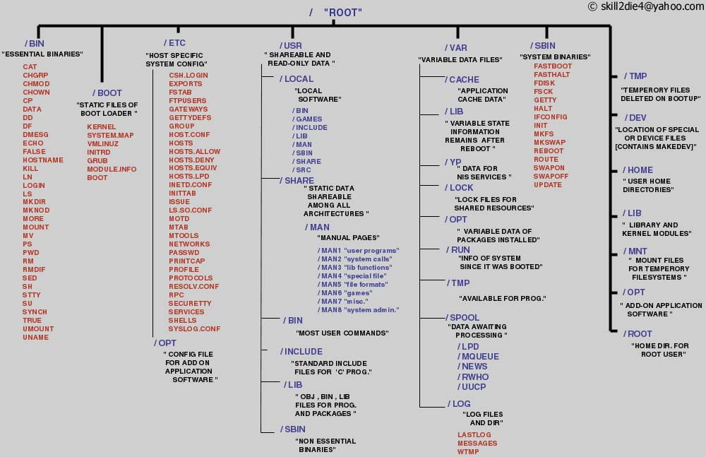
“Standard” directory structure of a Linux filesystem
For descriptions, see: http://www.pathname.com/fhs/pub/fhs-2.3.html

Slide 25
Assignment
@Canvas
  Module: Les 1 (DEEL 1 en DEEL 2)

Slide 26
Homework
Reference/Study
  OS:http://en.wikipedia.org/wiki/Operating_system#Components
  Linux: http://linux-training.be/files/books/LinuxFun.pdf H:1-9
Background information
  B: Silberschatz & Gagne: Operating system concepts
  B: Stallings: operating systems
  B: Tanenbaum: modern operating systems
  http://www.iu.hio.no/~mark/os/os.html
  http://physinfo.ulb.ac.be/cit_courseware/opsys/ostart.htm

Slide 27
End of Chapter

